Slide 1



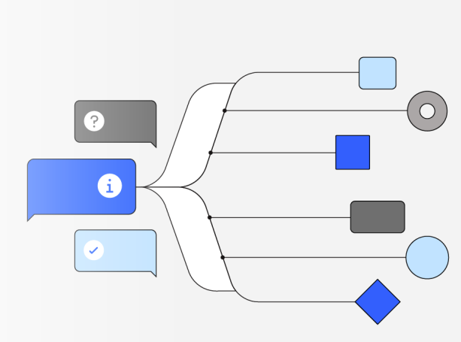
Cost Modelling for llm-d
Sima Nadler
June 2026

Slide 2
Problem
SaaS based AI models have mature pricing
Self-hosted models have no costing capabilities

Slide 3
SaaS Model Prices
Model
Base input tokens
Output Tokens
Context Size
Modality – text, image, audio, video
5 minute / 1 hour Cache Writes*
Cache Hits and Refreshes*
Data residency - Single region, multi-region, global endpoints
Fast mode ?
Batch processing - 50% discount over real-time
Tool Use
Client side tools - same as any other API request
Server side tools - additional usage-based pricing (eg web search charge)
The additional tokens from tool use come from:
The tools parameter in API requests (tool names, descriptions, and schemas)
tool_use content blocks in API requests and responses
tool_result content blocks in API requests
Managed Agents?
Session runtime
Volume discounts
Enterprise pricing
Custom rate limits
Volume discounts
Dedicated support
Custom terms
Pricing: Claude, OpenAI
*Claude Prompt Caching

Slide 4
Llm-d Cost Use Cases
Business
Enterprise IT
Build vs Buy
Compare cost of serving models independently vs using 3rd party hosted models
Enable individual and group level tracking of AI budgets – in $$ rather than just tokens
Monitor AI inference costs – overall, per model, per workload, per client, per region …
Llm-d “sales”
ROI for llm-d
Build vs Buy Decisions
And hybrid approaches
Llm-d Optimizations
Cost based model routing logic
Auto scaler can use real costs
instead of hard-coded costs currently provided via config files for each variant
Clients
Choose best model for intended purposes – based on cost/performance

Slide 5
Cost vs Price
Cost refers to what the provider (e.g., Anthropic, OpenAI, enterprise IT) spends to run inference
compute (GPUs/TPUs)
electricity
cooling
memory bandwidth
infrastructure overhead
personnel …
Price is what the provider charges customers
rate per million input/output tokens
Cache hit discounts
See this for more details
Cost ≠ Price: providers may price below cost to gain market share, or well above cost on premium models
User’s cost is the provider's price

Slide 6
Existing (Non-AI) Cost Tools
OpenCost( Open Source – CNCF) - Kubernetes and cloud cost monitoring and allocation
- Real-time cost allocation by namespace, pod, label
- Multi-cloud support (AWS, GCP, Azure, on-prem)
- Prometheus integration for metrics
- Cost allocation based on actual resource usage
- Idle resource cost tracking
Consumes existing Prometheus metrics and Kubernetes metadata to derive infrastructure cost data
KubeCost (Commercial - IBM Apptio) – Based on OpenCost
- Real-time cost monitoring
- Cost allocation and showback/chargeback
- Savings recommendations
- Multi-cluster support
Cloud Provider Native Tools (Commercial – Platform Specific)
RedHat: OpenShift Cost Management Metrics Service (paid)
GCP: Cloud Billing API, Cost Management
- AWS: Cost Explorer, Cost and Usage Reports
- Azure: Cost Management + Billing

Slide 7
OpenCost
Infrastructure (k8s) Level Metrics
Resource allocations
Node costs
Network costs
Storage costs
Costs associate with labels – namespace: node, service, deployment, stateful sets
Operation metrics
Business Level Metrics
Workload Costs (ex: cost of running a website)
Team Costs
Product Costs
Aggregation queries

Slide 8


NVIDIA DCGM included out of the box with OpenCost
NVIDIA DCGM
Data Center GPU Manager
OpenCost
or KubeCost
=
Actual GPU Use vs
GPU Allocation
+
Identify GPU Waste in $$
Notes:
What DCGM is Used For in OpenCost
DCGM (NVIDIA Data Center GPU Manager) metrics provide GPU utilization observability and efficiency analysis in OpenCost. Here are the specific use cases:
1. GPU Utilization Tracking
DCGM provides actual GPU usage metrics that OpenCost exposes in allocation data:
DCGM_FI_PROF_GR_ENGINE_ACTIVE → GPU utilization percentage
Average utilization (GPUUsageAverage): Shows typical GPU load over time
Maximum utilization (GPUUsageMax): Shows peak GPU usage
Stored in GPUAllocation object for each container
Purpose: Identify underutilized GPUs and optimize resource allocation
2. GPU Device Identification
DCGM provides hardware-level GPU information:
DCGM_FI_DEV_DEC_UTIL → Extracts GPU metadata:
Device number (GPUDevice): Physical GPU index (e.g., "0", "1")
Model name (GPUModel): GPU type (e.g., "Tesla V100", "A100-SXM4-40GB")
UUID (GPUUUID): Unique hardware identifier
Purpose: Track which specific GPU hardware is being used by each container
3. GPU Sharing Detection
Combined with Kubernetes metrics, DCGM helps identify GPU sharing scenarios:
Detects if multiple containers share a single GPU
Sets IsGPUShared flag (true/false/null)
Distinguishes between:
Dedicated GPU allocation (nvidia_com_gpu)
Shared GPU allocation (nvidia_com_gpu_shared)
Purpose: Understand GPU multi-tenancy and sharing patterns
4. Efficiency Analysis & Optimization
The combination of cost data + DCGM utilization enables:
Cost per utilized GPU-hour: Compare what you pay vs. what you use
Idle GPU detection: Find GPUs with low utilization but high cost
Right-sizing recommendations: Identify workloads that don't need full GPUs
Chargeback accuracy: Show teams their actual GPU usage vs. allocation
Example Use Case:
Container A:
- Allocated: 1 GPU (costs $2.50/hour)
- Actual Usage (from DCGM): 15% average utilization
- Analysis: Paying for full GPU but only using 15% → candidate for GPU sharing
What DCGM is NOT Used For:
❌ Cost calculation - Costs are based on Kubernetes resource requests, not DCGM usage ❌ Billing - You're charged for GPU allocation, not utilization ❌ Resource scheduling - Kubernetes scheduler uses requests/limits, not DCGM
Summary:
DCGM provides the "actual usage" layer on top of OpenCost's "allocated cost" layer. This enables:
FinOps teams: Identify waste and optimize GPU spending
Platform teams: Monitor GPU efficiency across clusters
Developers: Understand if their workloads efficiently use GPUs
Executives: See GPU ROI and utilization trends
Think of it as: Kubernetes tells you what you're paying for, DCGM tells you what you're actually using.

Slide 9
Inference Cost Monitoring
Business Level Metrics – examples:
Cost of self hosting AI models
and vs 3rd Party APIs
Usage Inference Costs per Team
Costs per Workload
Costs per Model
Costs per Model Variant
deployed with different hardware, LoRa, etc
Cost per Token
Per Model, Model Variant
KV Cache Costs and Savings
vllm
+ Llm-d
+ OpenCost
Metrics
Aggregation queries
base inference metrics (token latency, token throughput, cache)
EPP metrics track how requests are routed, scheduled, and load-balanced across multiple vLLM instances
GPU + other costs

Slide 10
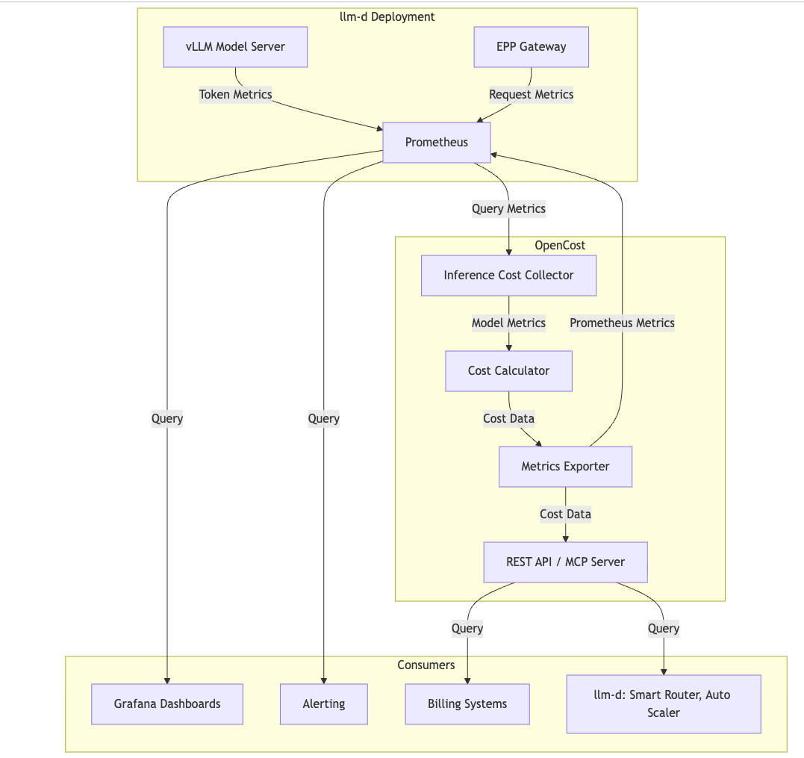
Architecture

Slide 11
Status
Task | Status | Comments
POC on Research Cluster | Complete Detailed review by OpenCost team | Included GPU costs only
Detailed proposal | Complete and Approved by OpenCost and llm-d | Submitted as an llm-d proposal Link from related OpenCost issue to proposal, to obtain input from both communities
Kubecon Submission | Submitted | Joint talk with OpenCost maintainer
OpenCost – Added Inference Costs | PR Submitted and under review
Inference Cost Evaluation | In Progress | Deployed on Research OpenShift cluster and cost numbers being evaluated for accuracy
Llm-d – Updates to add inference costs | Work in Progress

Slide 12
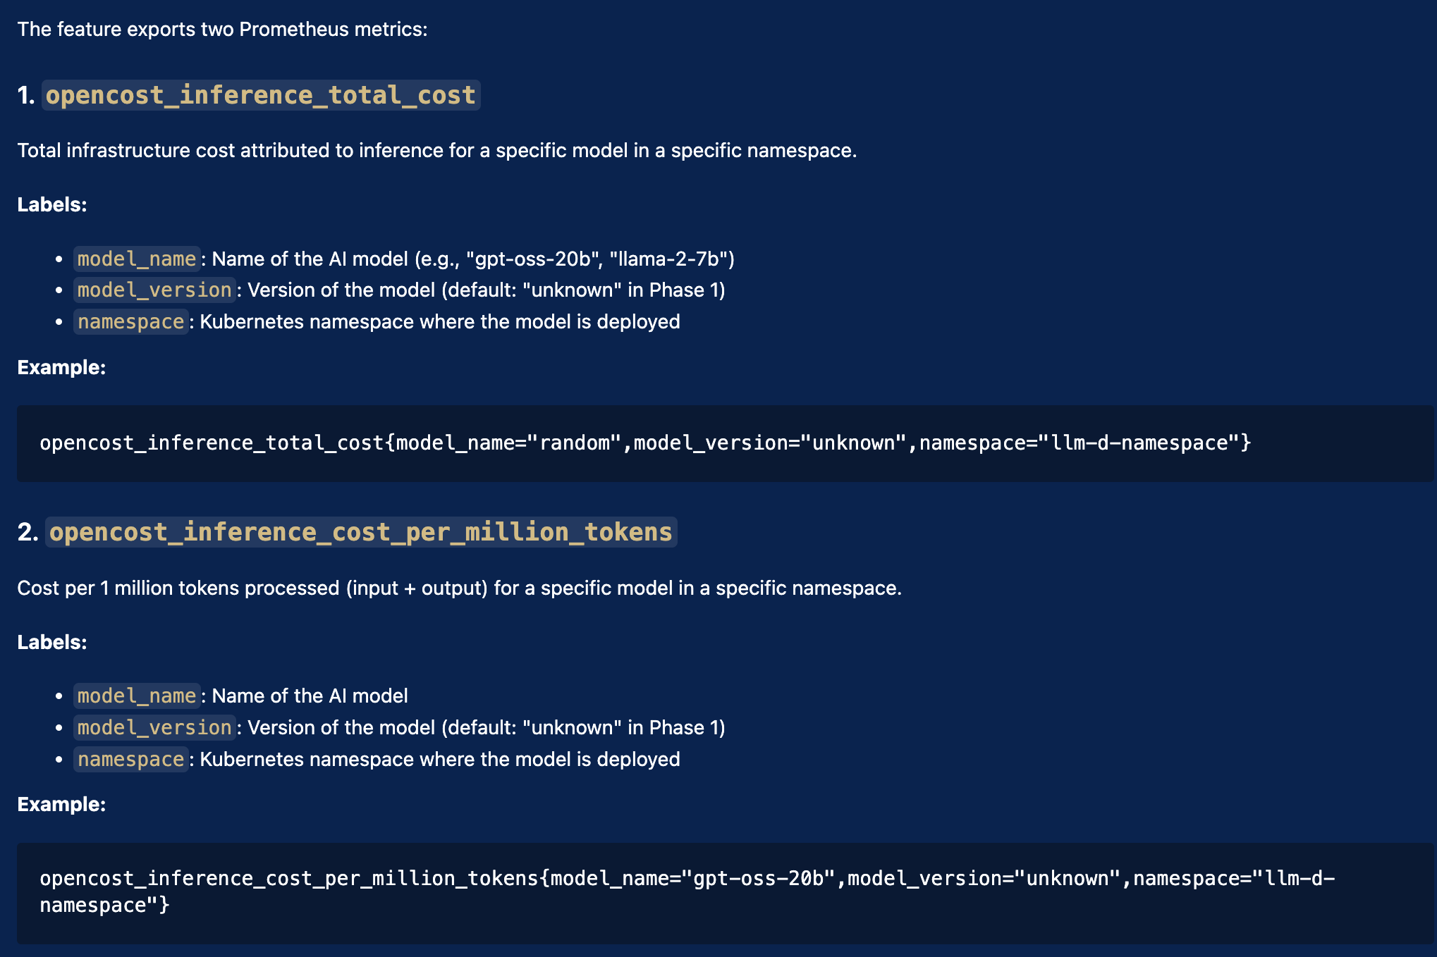
OpenCost POC
New Inference Metrics
Overall model cost
Cost per million tokens per model
Cost per million input tokens
Cost per million output tokens
Based on OpenCost
Running in Research OpenShift Cluster
Using dedicated Prometheus instance
Details

Slide 13
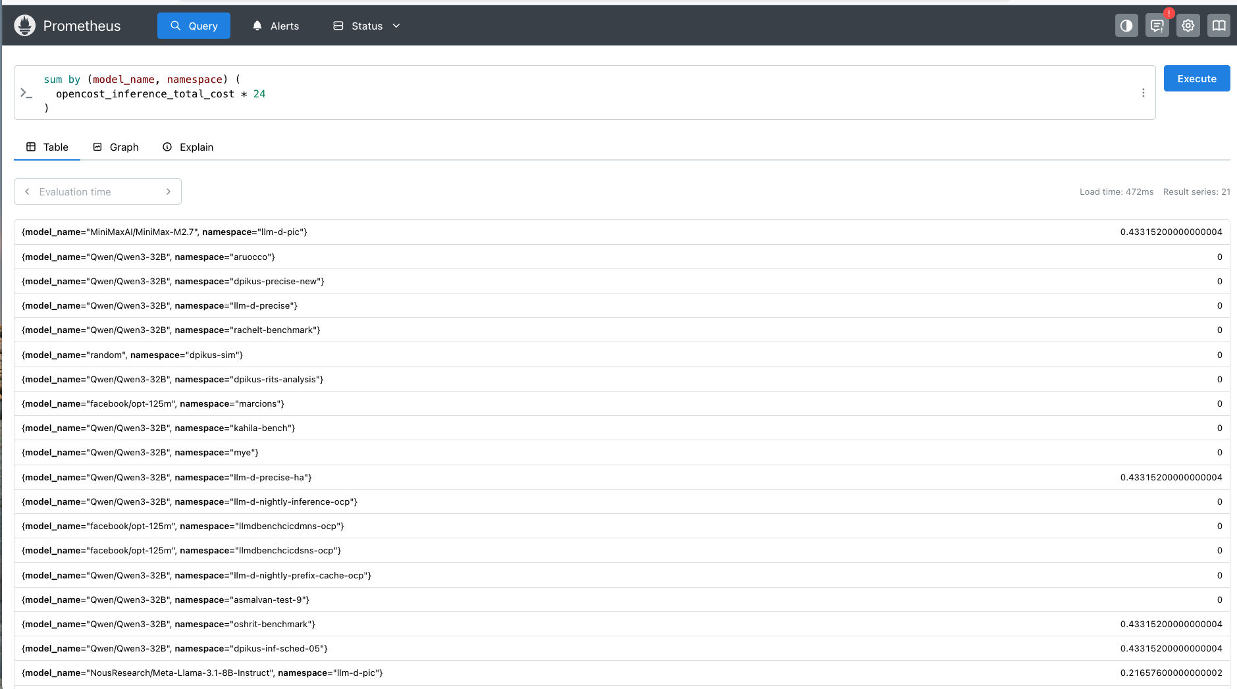

Slide 14
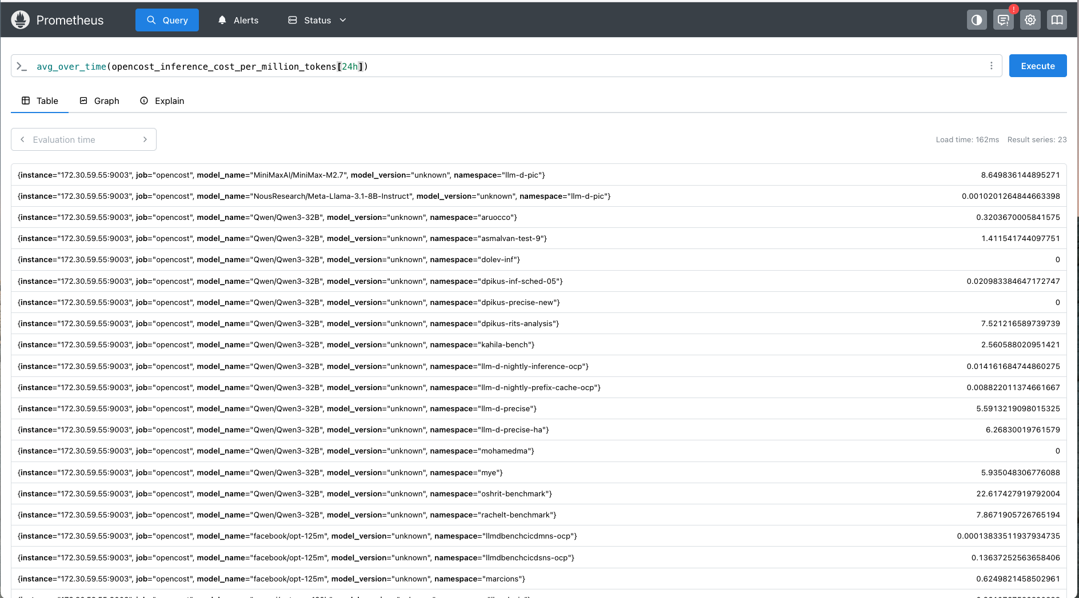

Slide 15
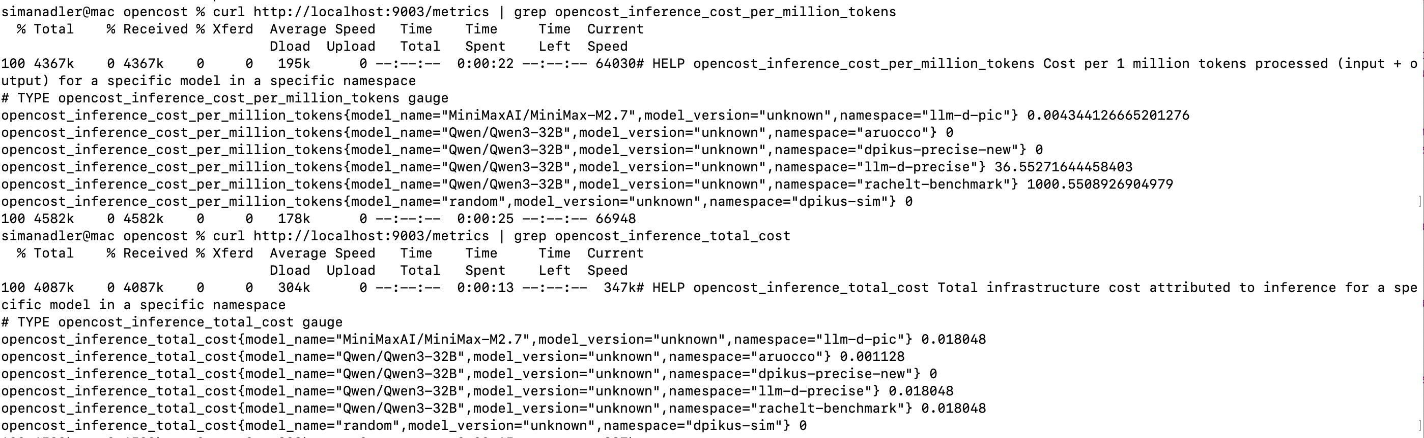
OpenCost POC

Slide 16

תודה

Slide 17
Self Hosted Inference Costs vs Frontier Model Pricing
Claude, OpenAI
*Claude Prompt Caching
3rd Party Charging Param | Proposed Llm-d Metric | Relevant llm-d Atributes
Cost per input, output token Data Residency Batch Discount | Cost per token / million tokens | model, input tokens, output tokens, client region, workload type
Cache Refreshes | Caching Cost | Model
Cache Hits | Caching Savings | model
Tool Usage | Tool Usage Costs | Model, Tool Tokens, Tool Service Charges
Support | Overhead | Staff
Context Length | Model | Model Variant
Modality – text, audio, video, image | Text only??

Slide 18
Llm-d Concepts
Concept | Example | Scope
Model | meta/llama-3.1-8b | Each inference pool deploys only one model, and typically each model will be deployed in one inference pool
Model variant | meta/llama-3.1-8b: Prefill meta/llama-3.1-8b: decode --- meta/llama-3.1-8b: Dev meta/llama-3.1-8b: Prod | Same model on different GPU types (A100 vs H100 vs L4), different LoRa, different serving configurations and different cost/performance characteristics Scaling is done at model variant level
KV Cache |  | Model level. Can be shared between variants of the same model but not between models
InferencePool |  | Collection of model variants & mechanisms for managing them – routers, KV cache, auto scaler, …

Slide 19
Existing Metrics
Inference Metrics
1. vLLM provides the foundation: All base inference metrics (token latency, token throughput, cache) come from vLLM's Prometheus endpoint
2. llm-d adds orchestration intelligence: EPP metrics track how requests are routed, scheduled, and load-balanced across multiple vLLM instances
3. Complementary insights: vLLM metrics show per model variant performance; llm-d metrics show system-wide (multi-model and multi-variant) routing efficiency and resource utilization
OpenCost Metrics
Ingested – k8s metrics
node metrics from node-exporter
State metrics from kube-state-metrics
Generated
Node costs
Resource allocations
Network costs
Storage cost
Costs associate with labels – namespace: node, service, deployment, stateful sets
Operation metrics

Slide 20
Attributes
Attribute | Example | Description
AI phase | Inference, training, finetune, eval | AI workload type
Model ID | meta/llama-3.1-8b | = llm-d InferencePool
Model variant | Prefill model / decode model Dev vs Production deployments of same model | Same model on different GPU types (A100 vs H100 vs L4), different LoRa, different serving configurations and different cost/performance characteristics
Client ID / cost center + UserID | HR, marketing, dev + JoeSmith | Multi-tenant allocation
Region | US-east, Europe | Geographic origin of the request
Workload ID | Travel Agent, Customer Support BOT | Some identifier for the workload being run by the client
Workload Type | Batch, Interactive | Affects the acceptable latency and price
Cluster ID + llm-d deployment ID + cluster region
Notes:
If you're referring to completely different model versions (different model IDs), they should be in separate InferencePools because:
InferencePool spec requires all pods to share the same Model
Each InferencePool has one EPP that maintains model-specific scheduling state
Different models have different KV-cache patterns and optimization requirements
2. Different Hardware/Configuration Variants of the Same Model → Same InferencePool
If you're referring to variants (same model served with different hardware or configurations), they can share the same InferencePool. This is the WVA use case:
Model Variants are different ways of serving the same model (same modelID):
Same model on different GPU types (A100 vs H100 vs L4)
Same model with different serving configurations
Same model with different cost/performance characteristics
How WVA Works with InferencePools:
Multiple VariantAutoscaling resources can have the same modelID
Each variant is a separate scale target (Deployment/StatefulSet/LWS)
All variants serving the same model can be discovered by the same InferencePool via label selectors
The EPP routes requests across all available endpoints (from all variants)
WVA manages which variant to scale based on cost optimization (scale up cheapest, scale down most expensive)
Example:
# Both variants serve meta/llama-3.1-8b and can join the same InferencePool
apiVersion: llmd.ai/v1alpha1
kind: VariantAutoscaling
metadata:
name: llama-8b-l4
spec:
modelID: "meta/llama-3.1-8b" # Same model
scaleTargetRef:
name: llama-8b-l4-deployment
variantCost: "5.0"
---
apiVersion: llmd.ai/v1alpha1
kind: VariantAutoscaling
metadata:
name: llama-8b-a100
spec:
modelID: "meta/llama-3.1-8b" # Same model
scaleTargetRef:
name: llama-8b-a100-deployment
variantCost: "15.0"
Both deployments can use the same label (e.g., llm-d.ai/model: llama-3.1-8b) and be discovered by one InferencePool, while WVA optimizes capacity allocation across them.
Summary
Different model versions (Llama 3.1 vs 3.2) → Different InferencePools
Different hardware variants of the same model → Same InferencePool (with WVA managing cost-optimized scaling)

Slide 21
SaaS Model Costs
Model
Base input tokens
5 minute / 1 hour Cache Writes*
Cache Hits and Refreshes*
Output Tokens
Data residency - Single region, multi-region, global endpoints
Fast mode ?
Batch processing - 50% discount over real-time
Batch input
Batch output
Context Size
Modality – text, image, audio, video
Tool Use
Client side tools - same as any other API request
Server side tools - additional usage-based pricing (eg web search charge)
The additional tokens from tool use come from:
The tools parameter in API requests (tool names, descriptions, and schemas)
tool_use content blocks in API requests and responses
tool_result content blocks in API requests
Managed Agents?
Session runtime
Volume discounts
Enterprise pricing
Custom rate limits
Volume discounts
Dedicated support
Custom terms
Pricing: Claude, OpenAI
*Claude Prompt Caching

Slide 22
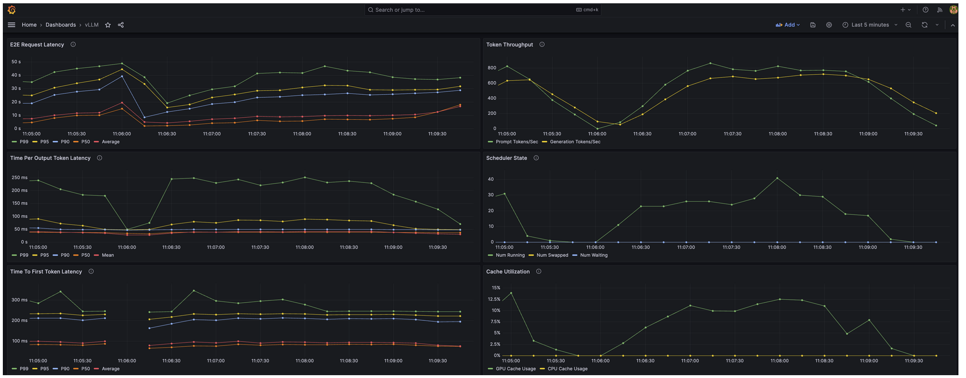
vLLM Metrics
vLLM
Performance Statistics Dashboard
Tracks latency, throughput, and performance metrics:
- Time to First Token (TTFT)
- Inter-token latency
- Request throughput
- Token generation rates
Query Statistics Dashboard
Monitors request volume, query performance, and KPIs:
- Request rates and volumes
- Query success/failure rates
- Request queue metrics
See notes for details
Notes:
vllm_worker_request_latency_seconds (histogram) — latency of processing requests (scheduling + execution). vllm_worker_queue_time_seconds (histogram) — time requests spend waiting in scheduler queue. vllm_worker_execution_time_seconds (histogram) — time spent actually executing model tokens. vllm_worker_tokens_processed_total (counter) — total tokens processed by workers. vllm_worker_tokens_generated_total (counter) — total tokens generated (output). vllm_worker_active_workers (gauge) — number of active worker threads/processes. vllm_worker_memory_bytes (gauge) — memory used by each worker (bytes). vllm_worker_gpu_memory_bytes (gauge) — GPU memory used (bytes) when applicable. vllm_worker_batch_size (gauge) — current inference batch size. vllm_worker_batching_wait_time_seconds (histogram) — time spent waiting to form batches. vllm_worker_request_count_total (counter) — total number of requests handled. vllm_worker_request_errors_total (counter) — number of errored requests. vllm_worker_model_load_time_seconds (gauge or histogram) — time to load models into workers

Slide 23
llm-d Metrics
Tier 1: Core vLLM Metrics (via PodMonitors)
- `vllm:time_to_first_token_seconds` - TTFT latency histograms
- `vllm:inter_token_latency_seconds` - Inter-token latency histograms
- `vllm:kv_cache_usage_perc` - KV cache utilization percentage
- `vllm:num_requests_waiting` - Request queue lengths
- `vllm:num_requests_running` - Active requests
- `vllm:num_preemptions` - Request preemption counts
- `vllm:prompt_tokens_total` - Prompt token counters
- `vllm:generation_tokens_total` - Generation token counters
- `vllm:prefix_cache_hits_total` - Prefix cache hit counters
- `vllm:prefix_cache_queries_total` - Prefix cache query counters
Tier 3: P/D Disaggregation Metrics
Specialized metrics for prefill/decode separation:
`llm_d_inference_scheduler_pd_decision_total`
- P/D routing decisions
- Separate tracking for prefill vs decode worker utilization
Tier 2: EPP (Endpoint Picker) Metrics (Collected via ServiceMonitors)
- `inference_objective_request_total` - Total requests by model
- `inference_objective_request_error_total` - Error counts by type
- `inference_objective_request_duration_seconds` - E2E request latency
- `inference_extension_scheduler_e2e_duration_seconds` - EPP scheduling latency
- `inference_extension_plugin_duration_seconds` - Plugin processing times
- `inference_extension_prefix_indexer_size` - Prefix cache index size
- `inference_extension_prefix_indexer_hit_ratio` - Cache hit ratios
- `inference_extension_flow_control_queue_size` - Flow control queue metrics

Slide 24
Proposed Cost Metrics
Metric | Can Be Broken Down by Attributes
Overall Cost | AI phase, model, model variant, client ID, user ID, workload ID, cluster region, user region, workload type
Cost per token / million tokens | AI phase, model, model variant, client & user ID, workload ID, cluster region, cluster ID, llm-d instance, input tokens, output tokens, tool tokens, workload type
Caching Cost | model, model variant, client ID, workload ID, cluster ID, cluster region, llm-d instance
Caching Savings | AI phase, model, model variant, client ID, workload ID, cluster ID, cluster region, llm-d instance
Idle Costs | Overall, model, model variant, cluster ID, cluster region, llm-d instance
Tool Usage Costs | AI phase, model, model variant, client & user ID, workload ID, cluster region, cluster ID, llm-d instance, workload type
Overhead Costs | Staff, Model Training, Data Center Overhead, …
Note: Costs may be broken down into allocation, usage and overhead as described here.
Notes:
If you're referring to completely different model versions (different model IDs), they should be in separate InferencePools because:
InferencePool spec requires all pods to share the same Model
Each InferencePool has one EPP that maintains model-specific scheduling state
Different models have different KV-cache patterns and optimization requirements
Different Hardware/Configuration Variants of the Same Model → Same InferencePool
If you're referring to variants (same model served with different hardware or configurations), they can share the same InferencePool. This is the WVA use case:
Model Variants are different ways of serving the same model (same modelID):
Same model on different GPU types (A100 vs H100 vs L4)
Same model with different serving configurations
Same model with different cost/performance characteristics
How WVA Works with InferencePools:
Multiple VariantAutoscaling resources can have the same modelID
Each variant is a separate scale target (Deployment/StatefulSet/LWS)
All variants serving the same model can be discovered by the same InferencePool via label selectors
The EPP routes requests across all available endpoints (from all variants)
WVA manages which variant to scale based on cost optimization (scale up cheapest, scale down most expensive)
Example:
# Both variants serve meta/llama-3.1-8b and can join the same InferencePool
apiVersion: llmd.ai/v1alpha1
kind: VariantAutoscaling
metadata:
name: llama-8b-l4
spec:
modelID: "meta/llama-3.1-8b" # Same model
scaleTargetRef:
name: llama-8b-l4-deployment
variantCost: "5.0"
---
apiVersion: llmd.ai/v1alpha1
kind: VariantAutoscaling
metadata:
name: llama-8b-a100
spec:
modelID: "meta/llama-3.1-8b" # Same model
scaleTargetRef:
name: llama-8b-a100-deployment
variantCost: "15.0"
Both deployments can use the same label (e.g., llm-d.ai/model: llama-3.1-8b) and be discovered by one InferencePool, while WVA optimizes capacity allocation across them.
Summary
Different model versions (Llama 3.1 vs 3.2) → Different InferencePools
Different hardware variants of the same model → Same InferencePool (with WVA managing cost-optimized scaling)

Slide 25
Leverage Existing Metrics
Cost Metric | Attributes | Existing Metrics | Gaps
Overall Cost | AI phase, model, model variant, client ID, user ID, workload ID, cluster region, user region, workload type | OpenCost: k8s costs, OpenCost: cloud costs | Client, user, workload
Cost per token / million tokens | AI phase, model, model variant, client & user ID, workload ID, cluster region, cluster ID, llm-d instance, input tokens, output tokens, tool tokens, workload type | - `vllm:prompt_tokens_total` - Prompt token counters `vllm:generation_tokens_total` - Generation token counters OpenCost k8s costs | Tool tokens client, user, workload metrics
Caching Cost | model, model variant, client ID, workload ID, cluster ID, cluster region, llm-d instance | vllm:kv_cache_usage_perc | client, user, workload metrics
Caching Savings | AI phase, model, model variant, client ID, workload ID, cluster ID, cluster region, llm-d instance | - `vllm:prefix_cache_hits_total` - Prefix cache hit counters - `vllm:prefix_cache_queries_total` - OpenCost k8s costs | client, user, workload metrics
Idle Costs | Overall, model, model variant, cluster ID, cluster region, llm-d instance | OpenCost: Idle Costs | Model, model variant
Tool Usage Costs | AI phase, model, model variant, client & user ID, workload ID, cluster region, cluster ID, llm-d instance, workload type |  | No tool token statistics collected by vllm nor tool services calls
Overhead | Staff, Model Training, Data Center Overhead, … |  | Custom config for staff, data center, and other overhead in OpenCost
Notes:
If you're referring to completely different model versions (different model IDs), they should be in separate InferencePools because:
InferencePool spec requires all pods to share the same Model
Each InferencePool has one EPP that maintains model-specific scheduling state
Different models have different KV-cache patterns and optimization requirements
2. Different Hardware/Configuration Variants of the Same Model → Same InferencePool
If you're referring to variants (same model served with different hardware or configurations), they can share the same InferencePool. This is the WVA use case:
Model Variants are different ways of serving the same model (same modelID):
Same model on different GPU types (A100 vs H100 vs L4)
Same model with different serving configurations
Same model with different cost/performance characteristics
How WVA Works with InferencePools:
Multiple VariantAutoscaling resources can have the same modelID
Each variant is a separate scale target (Deployment/StatefulSet/LWS)
All variants serving the same model can be discovered by the same InferencePool via label selectors
The EPP routes requests across all available endpoints (from all variants)
WVA manages which variant to scale based on cost optimization (scale up cheapest, scale down most expensive)
Example:
# Both variants serve meta/llama-3.1-8b and can join the same InferencePool
apiVersion: llmd.ai/v1alpha1
kind: VariantAutoscaling
metadata:
name: llama-8b-l4
spec:
modelID: "meta/llama-3.1-8b" # Same model
scaleTargetRef:
name: llama-8b-l4-deployment
variantCost: "5.0"
---
apiVersion: llmd.ai/v1alpha1
kind: VariantAutoscaling
metadata:
name: llama-8b-a100
spec:
modelID: "meta/llama-3.1-8b" # Same model
scaleTargetRef:
name: llama-8b-a100-deployment
variantCost: "15.0"
Both deployments can use the same label (e.g., llm-d.ai/model: llama-3.1-8b) and be discovered by one InferencePool, while WVA optimizes capacity allocation across them.
Summary
Different model versions (Llama 3.1 vs 3.2) → Different InferencePools
Different hardware variants of the same model → Same InferencePool (with WVA managing cost-optimized scaling)

Slide 26
Leverage Existing Metrics
Cost Metric | Existing Metrics | Gaps
Overall Cost | OpenCost: k8s costs, OpenCost: cloud costs | Client, user, workload
Cost per token / million tokens | - `vllm:prompt_tokens_total` - Prompt token counters `vllm:generation_tokens_total` - Generation token counters OpenCost k8s costs | Tool tokens client, user, workload metrics
Caching Cost | vllm:kv_cache_usage_perc | client, user, workload metrics
Caching Savings | - `vllm:prefix_cache_hits_total` - Prefix cache hit counters - `vllm:prefix_cache_queries_total` - OpenCost k8s costs | client, user, workload metrics
Idle Costs | OpenCost: Idle Costs | Model, model variant
Tool Usage Costs |  | No tool token statistics collected by vllm nor tool services calls
Overhead |  | Custom config for staff, data center, and other overhead in OpenCost
Notes:
If you're referring to completely different model versions (different model IDs), they should be in separate InferencePools because:
InferencePool spec requires all pods to share the same Model
Each InferencePool has one EPP that maintains model-specific scheduling state
Different models have different KV-cache patterns and optimization requirements
2. Different Hardware/Configuration Variants of the Same Model → Same InferencePool
If you're referring to variants (same model served with different hardware or configurations), they can share the same InferencePool. This is the WVA use case:
Model Variants are different ways of serving the same model (same modelID):
Same model on different GPU types (A100 vs H100 vs L4)
Same model with different serving configurations
Same model with different cost/performance characteristics
How WVA Works with InferencePools:
Multiple VariantAutoscaling resources can have the same modelID
Each variant is a separate scale target (Deployment/StatefulSet/LWS)
All variants serving the same model can be discovered by the same InferencePool via label selectors
The EPP routes requests across all available endpoints (from all variants)
WVA manages which variant to scale based on cost optimization (scale up cheapest, scale down most expensive)
Example:
# Both variants serve meta/llama-3.1-8b and can join the same InferencePool
apiVersion: llmd.ai/v1alpha1
kind: VariantAutoscaling
metadata:
name: llama-8b-l4
spec:
modelID: "meta/llama-3.1-8b" # Same model
scaleTargetRef:
name: llama-8b-l4-deployment
variantCost: "5.0"
---
apiVersion: llmd.ai/v1alpha1
kind: VariantAutoscaling
metadata:
name: llama-8b-a100
spec:
modelID: "meta/llama-3.1-8b" # Same model
scaleTargetRef:
name: llama-8b-a100-deployment
variantCost: "15.0"
Both deployments can use the same label (e.g., llm-d.ai/model: llama-3.1-8b) and be discovered by one InferencePool, while WVA optimizes capacity allocation across them.
Summary
Different model versions (Llama 3.1 vs 3.2) → Different InferencePools
Different hardware variants of the same model → Same InferencePool (with WVA managing cost-optimized scaling)

